Slide 1

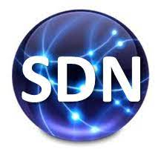
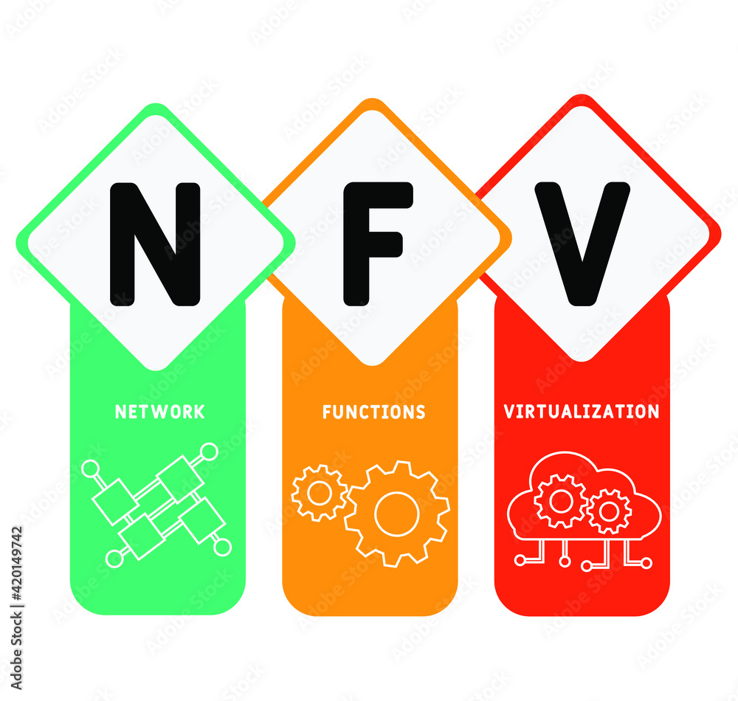

PDS
Computer Vision
Docker
Docker-Image
for Deep Learning
.
https://github.com/siagianp
https://www.youtube.com/@AmelOline/videos
https://github.com/amelcharolinesgn2/IoT_simulator-mqtt-NodeRed
https://github.com/amelcharolinesgn2/Cloud-Infrastructures
https://github.com/amelcharolinesgn2/ClouD-Infrastructure-SISKA-2025
Notes:
https://docs.ultralytics.com/yolov5/environments/docker_image_quickstart_tutorial/#step-3-use-yolov5-within-the-docker-container
https://github.com/ultralytics/ultralytics/issues/6374

Slide 2
Exampe 3
Get Started with YOLOv5 🚀 in Docker
Prerequisites
Before you begin, ensure you have the following installed:
Docker: Download and install Docker from the official Docker website. Docker is essential for creating and managing containers.
NVIDIA Drivers (Required for GPU support): Ensure you have NVIDIA drivers version 455.23 or higher installed. You can download the latest drivers from NVIDIA's website.
NVIDIA Container Toolkit (Required for GPU support): This toolkit allows Docker containers to access your host machine's NVIDIA GPUs. Follow the official NVIDIA Container Toolkit installation guide for detailed instructions.
Setting up NVIDIA Container Toolkit (GPU Users)
This command should display information about your GPU(s) and the installed driver version.
Next, install the NVIDIA Container Toolkit.
curl -fsSL https://nvidia.github.io/libnvidia-container/gpgkey | sudo gpg --dearmor -o /usr/share/keyrings/nvidia-container-toolkit-keyring.gpg \ && curl -s -L https://nvidia.github.io/libnvidia-container/stable/deb/nvidia-container-toolkit.list \ | sed 's#deb https://#deb [signed-by=/usr/share/keyrings/nvidia-container-toolkit-keyring.gpg] https://#g' \ | sudo tee /etc/apt/sources.list.d/nvidia-container-toolkit.list
First, verify that your NVIDIA drivers are installed correctly by running:
nvidia-smi
Notes:
https://docs.ultralytics.com/yolov5/environments/docker_image_quickstart_tutorial/#step-3-use-yolov5-within-the-docker-container

Slide 3
Exampe 3
Get Started with YOLOv5 🚀 in Docker (Cons’t)
Update the package lists and install the nvidia-container-toolkit package:
sudo apt-get update
Install Latest version of nvidia-container-toolkit
sudo apt-get install -y nvidia-container-toolkit \
nvidia-container-toolkit-base libnvidia-container-tools \
libnvidia-container1
Optional: Install specific version of nvidia-container-toolkit
sudo nvidia-ctk runtime configure --runtime=docker
sudo systemctl restart docker
Verify NVIDIA Runtime with Docker
Run docker info | grep -i runtime to ensure that nvidia appears in the list of runtimes:
docker info | grep -i runtime
You should see nvidia listed as one of the available runtimes.
Notes:
https://docs.ultralytics.com/yolov5/environments/docker_image_quickstart_tutorial/#step-3-use-yolov5-within-the-docker-container

Slide 4
Exampe 3
Get Started with YOLOv5 🚀 in Docker (Cons’t)
Step 1: Pull the YOLOv5 Docker Image
Ultralytics provides official YOLOv5 images on Docker Hub. The latest tag tracks the most recent repository commit, ensuring you always get the newest version. Pull the image using the following command:
Step 2: Run the Docker Container
Once the image is pulled, you can run it as a container.
Using CPU Only
To run an interactive container instance using only the CPU, use the -it flag. The --ipc=host flag allows sharing of host IPC namespace, which is important for shared memory access.
# Define the image name with tag
t=ultralytics/yolov5:latest
# Pull the latest YOLOv5 image from Docker Hub
sudo docker pull $t
You can browse all available images at the Ultralytics YOLOv5 Docker Hub repository.
# Run an interactive container instance using CPU sudo docker run -it --runtime=nvidia --ipc=host $t
Notes:
https://docs.ultralytics.com/yolov5/environments/docker_image_quickstart_tutorial/#step-3-use-yolov5-within-the-docker-container

Slide 5
Exampe 3
Get Started with YOLOv5 🚀 in Docker (Cons’t)
Mounting Local Directories
To work with your local files (datasets, model weights, etc.) inside the container, use the -v flag to mount a host directory into the container:
Using GPU
To enable GPU access within the container, use the --gpus flag. This requires the NVIDIA Container Toolkit to be installed correctly.
# Mount /path/on/host (your local machine) to /path/in/container (inside the container)
sudo docker run -it --runtime=nvidia --ipc=host --gpus all -v /path/on/host:/path/in/container $t
# Run with access to all available GPUs sudo docker run -it --runtime=nvidia --ipc=host --gpus all $t # Run with access to specific GPUs (e.g., GPUs 2 and 3) sudo docker run -it --runtime=nvidia --ipc=host --gpus '"device=2,3"' $t
Refer to the Docker run reference for more details on command options.
Replace /path/on/host with the actual path on your machine and /path/in/container with the desired path inside the Docker container (e.g., /usr/src/datasets).
Notes:
https://docs.ultralytics.com/yolov5/environments/docker_image_quickstart_tutorial/#step-3-use-yolov5-within-the-docker-container

Slide 6
Exampe 3
Get Started with YOLOv5 🚀 in Docker (Cons’t)
Explore the documentation for detailed usage of different modes:
Train
Validate
Predict
Export
Learn more about evaluation metrics like Precision, Recall, and mAP. Understand different export formats like ONNX, CoreML, and TFLite, and explore various Model Deployment Options. Remember to manage your model weights effectively.
Step 3: Use YOLOv5 🚀 within the Docker Container
You are now inside the running YOLOv5 Docker container! From here, you can execute standard YOLOv5 commands for various Machine Learning and Deep Learning tasks like Object Detection.
# Train a YOLOv5 model on your custom dataset (ensure data is mounted or downloaded)
python train.py --data your_dataset.yaml --weights yolov5s.pt --img 640 # Start training
# Validate the trained model's performance (Precision, Recall, mAP)
python val.py --weights path/to/your/best.pt --data your_dataset.yaml # Validate accuracy
# Run inference on images or videos using a trained model
python detect.py --weights yolov5s.pt --source path/to/your/images_or_videos # Perform detection
# Export the trained model to various formats like ONNX, CoreML, or TFLite for deployment
python export.py --weights yolov5s.pt --include onnx coreml tflite # Export model
Notes:
https://docs.ultralytics.com/yolov5/environments/docker_image_quickstart_tutorial/#step-3-use-yolov5-within-the-docker-container

Slide 7
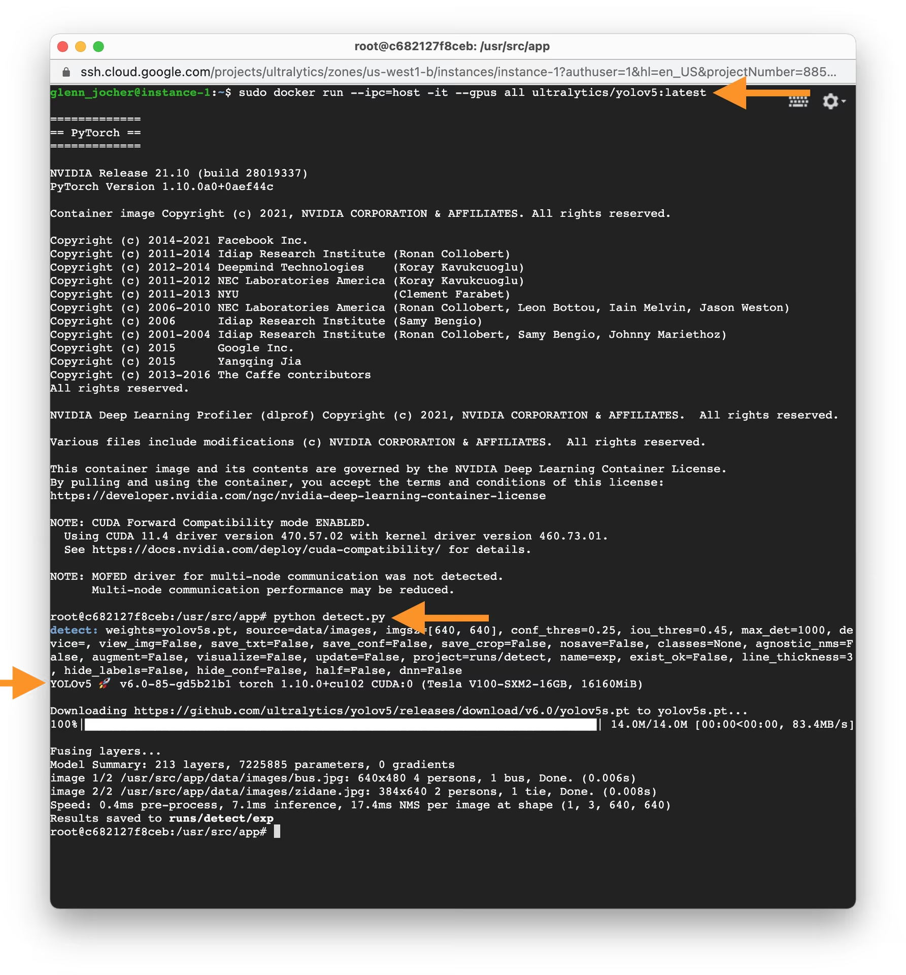
Exampe 3
Get Started with YOLOv5 🚀 in Docker (Cons’t)
Notes:
https://docs.ultralytics.com/yolov5/environments/docker_image_quickstart_tutorial/#step-3-use-yolov5-within-the-docker-container

Slide 8
Mauliate Godang

